Slide 1
CS 4530
Fundamentals of Software Engineering
Lesson 11: Code Smells, Refactoring and Technical Debt
Jonathan Bell, Adeel Bhutta, Ferdinand Vesely, Mitch Wand
Khoury College of Computer Sciences
© 2021 Released under the CC BY-SA license

Slide 2
Learning Goals
By the end of this lesson, you should be able to…
Some common code “smells” (anti-patterns).
“Refactoring”: restructuring of code to improve structure.
“Technical Debt”: generalization covering all internal problems in a code-base.

Slide 3
Refactoring
refactoring is the process of applying transformations (refactorings) to a program, with the goal of improving its design
goals:
keep program readable, understandable, and maintainable
by eliminating small problems soon, you can avoid big trouble later
characteristics:
behavior-preserving: make sure the program works after each step
small steps
Notes:
The process of changing the source code of a software system such that:
The external (observable) behavior of the system does not change - e.g., functional requirements are maintained
But the internal structure of the system is improved

Slide 4
Learning Objectives for this Lesson
By the end of this lesson, you should be able to:
Review several classes of code smells;
Describe several kinds of refactoring;
Identify the “technical debt” metaphor;
Indicate when and where technical debt is appropriate to accrue versus retire.
Notes:
The process of changing the source code of a software system such that:
The external (observable) behavior of the system does not change - e.g., functional requirements are maintained
But the internal structure of the system is improved

Slide 5
History of Refactoring
refactoring is something good programmers have always done
Opdyke’s PhD thesis (1990): refactoring tools for Smalltalk
popularized by various agile development methodologies
especially popular in the context of object-oriented languages
OO features are well-suited to make designs flexible & reusable
but refactoring is not specific to OO

Slide 6

Refactoring
Martin Fowler
“Any fool can write code that a computer can understand. Good programmers write code that humans can understand.”
Notes:
Author of many works on software engineering methodology, including the seminal text on refactoring. Not inventor of refactoring by any means, but an evangelist for refactoring and related development methodologies

Slide 7

Fowler’s book
presents a catalogue of refactorings, similar to the catalogue of design patterns in the GoF book
catalogues “bad smells” - indications that refactoring may be needed
explains when and how to apply refactorings
many of Fowler’s refactorings are the inverse of another refactoring
often there is not a unique “best” solution
discussion of the tradeoffs
Notes:
also in the book:
UML diagrams to illustrate the situation before and after
examples of code before and after each refactoring
https://learning.oreilly.com/library/view/refactoring-improving-the/9780134757681/

Slide 8

Why Refactor?
requirements have changed, and a different design is needed
design needs to be more flexible (so new features can be added)
design patterns are often a target for refactoring
address sloppiness by programmers
Notes:
Characteristics that might be improved: Maintainability: Easier to read and understand, Easier to (further) modify, Easier to integrate, Easier to test

Slide 9
Example Refactoring
Consolidating duplicate conditional fragments
Original Code
Refactored Code
if (isSpecialDeal()) {
total = price * 0.95;
send()
} else {
total = price * 0.98;
send()
}
if (isSpecialDeal()) {
total = price * 0.95;
} else {
total = price * 0.98;
}
send()

Slide 10
Observations
small incremental steps that preserve program behavior
most steps are so simple that they can be automated
automation limited in complex cases
refactoring does not always proceed “in a straight line”
sometimes, undo a step you did earlier…
…when you have insights for a better design
Notes:
A disciplined technique for restructuring an existing body of code, altering its internal structure without changing its external behavior
Series of small behavior-preserving transformations
Each transformation does little, but a sequence of transformations can produce a significant restructuring
Since each refactoring is small, it's less likely to go wrong
The system is also kept fully working after each small refactoring (via regression testing), reducing the chances that a system can get seriously broken during the restructuring

Slide 11
When to refactor?
Refactoring is incremental redesign
Acknowledge that it will be difficult to get design right the first time
When adding new functionality, fixing a bug, doing code review, or any time
Refactoring evolves design in increments
Refactoring reduces technical debt
What do you refactor?
Notes:
When you add new functionality
Do it before you add the new function, to make it easier to add the function
Or do it after you add the function, to clean up the code including that function
When you need to fix a bug
As you do a code review
Whenever…
The idea behind refactoring is to acknowledge that it will be difficult to get a design right the first time
And as a program’s requirements change, the design may need to change
It is notoriously difficult (impossible?) to design for all possible changes a priori
And as agile programming proponents say, “You aren’t gonna need it” – but what if later you do?
Refactoring provides techniques for evolving the design in small incremental steps
Technical debt: The project’s requirements are constantly changing and at some point it may become obvious that parts of the code are obsolete, have become cumbersome, and must be redesigned to meet new requirements. On the other hand, the project’s programmers are writing new code every day that works with the obsolete parts. Therefore, the longer refactoring is delayed, the more dependent code will have to be reworked in the future.

Slide 12
Code Smells
Mysterious Name
“We may fantasize about being International Men of Mystery, but our code needs to be mundane and clear”
- Martin Fowler on “Mysterious Name”
“Refactoring: Improving the Design of Existing Code,” Martin Fowler, 1992
Notes:
Sadly, however, naming is one of the two hardest things in programming. So, perhaps the most common refactorings we do are the renames: Change Function Declaration (124) (to rename a function), Rename Variable (137), and Rename Field (244). People are often afraid to rename things, thinking it’s not worth the trouble, but a good name can save hours of puzzled incomprehension in the future.
Renaming is not just an exercise in changing names. When you can’t think of a good name for something, it’s often a sign of a deeper design malaise. Puzzling over a tricky name has often led us to significant simplifications to our code.

Slide 13
Code Smells
Shotgun Surgery
“When the changes are all over the place, they are hard to find, and it’s easy to miss an important change.”
- Martin Fowler on “Shotgun Surgery”
“Refactoring: Improving the Design of Existing Code,” Martin Fowler, 1992
Notes:
Shotgun surgery is similar to divergent change but is the opposite. You whiff this when, every time you make a change, you have to make a lot of little edits to a lot of different classes.

Slide 14
Code Smells
A complete list (links to book!)
Mysterious Name
Duplicated Code
Long Function
Long Parameter List
Global Data
Mutable Data
Divergent Change
Shotgun Surgery
Feature Envy
Data Clumps
Primitive Obsession
Repeated Switches
Loops
Lazy Element
Speculative Generality
Temporary Field
Message Chains
Middle Man
Insider Trading
Large Class
Alternative Classes with Different Interfaces
Data Class
Refused Bequest
“Refactoring: Improving the Design of Existing Code,” Martin Fowler, 1992

Slide 15
“Local” Refactorings
Rename | rename variables, fields methods, classes, packages provide better intuition for the renamed element’s purpose
Extract Method | extract statements into a new method enables reuse; avoid cut-and-paste programming improve readability
Inline Method | replace a method call with the method’s body often useful as intermediate step
Extract Local | introduce a new local variable for a designated expression
Inline Local | replace a local variable with the expression that defines its value
Change Method Signature | reorder a method’s parameters
Encapsulate Field | introduce getter/setter methods
Convert Local Variable to Field | convert local variable to field sometimes useful to enable application of Extract Method
Notes:
some examples of widely used refactorings that are “local” in scope
useful for restructuring methods
We already talked about bad names and duplicate code. We would fix these smells by applying refactoring rename and extract method, resp
Inline method is inverse: when you want to go fold a method back into another
Extract local variable is like extract method, but what you might do with just an expression, so that a big expression can be more manageable
Again, inline local is the inverse: eliminating a local variable that is maybe superfluous
Change function declaration lets us adapt the order of parameters on a method
encapsulate a field replaces direct field accesses with getters/setters, and
Convert local to field creates a field with the specified scope to replace a local variable.
These are just a few of the hundreds of refactorings in Fowler’s book

Slide 16
Type-Related Refactorings
Generalize Declared Type | replace the type of a declaration with a more general type
Extract Interface | create a new interface, and update declarations to use it where possible
Pull Up Members | move methods and fields to a superclass
Infer Generic Type Arguments | infer type arguments for “raw” uses of generic types
Notes:
refactorings for changing the class hierarchy and/or the types of declarations of variables and fields
purpose is to make designs more flexible, e.g., by facilitating the introduction of design patterns
Way, way more refactoring than this. Again, over a hundred. What’s most useful is often what’s automated…

Slide 17
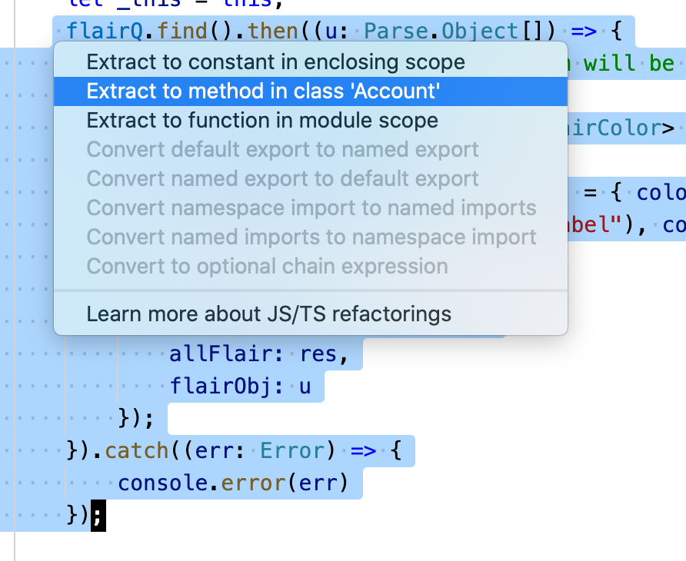
Automated Refactorings in VSC

Slide 18
Refactoring Risks
Developer time is valuable: is this the best use of time today?
Despite best intentions, may not be safe
Potential for version control conflicts
Notes:
If programmers spend time “cleaning up the code”, then that’s less time spent implementing required functionality - and the schedule is slipping as it is!
Refactoring can break code that previously worked
Refactoring needs to be systematic, incremental, and safe

Slide 19
This leads us into Technical Debt
Code smells and Refactoring are tightly coupled with Technical debt
In software-intensive systems, technical debt consists of design or implementation constructs that are expedient in the short term but that set up a technical context that can make a future change more costly or impossible.
Notes:
Ward Cunningham introduced the term “Technical Debt” in 1992 to communicate the delicate balance between speed and rework in pursuit of delivering functioning quality software. You can think of technical debt as an analogy with friction in mechanical devices; the more friction a device experiences due to wear and tear, lack of lubrication, or bad design, the harder it is to move the device, and the more energy you have to apply to get the original effect. At the same time, friction is a necessary condition of mechanical parts working together. You cannot eliminate it completely; you can only reduce its impact.
If programmers spend time “cleaning up the code”, then that’s less time spent implementing required functionality - and the schedule is slipping as it is!
Refactoring can break code that previously worked

Slide 20

Technical Debt is Internal but affects maintainability and evolvability
Technical debt is a contingent liability whose impact is limited to internal system qualities—­primarily, but not only, maintainability and evolvability.
Usual Scenarios:
Quick-and-Dirty if-then-else;
Hitting the Wall;
Crumbling Under the Load;
Death by a Thousand Cuts;
Tactical Investment.
Not just code!
Notes:
More details in this book: https://learning.oreilly.com/library/view/managing-technical-debt/9780135646052/
Quick-and-Dirty if-then-else: A quick and dirty solution for a smaller market might prompt the need for another larger change which can no longer be quick and dirty. Like adding support for one langage but then needing support for other languages.
Hitting the Wall: when a company develops a lot of code for demos (with new and new features) without any plan for overall architecture, they will eventually hit a wall and the developers will no longer to able to do anything due to scalability, data management, distribution of the system, and security issues
Crumbling Under the Load: there was no single cause of technical debt. There were hundreds of causes: code imperfections, tricks, and workarounds, compounded by no usable documentation and little automated testing. While the development team dreams of a complete rewrite, the economic situation does not allow delaying new releases or new products or abandoning support for older products.
Death by a Thousand Cuts: a pervasive lack of competence can result in many small, avoidable coding issues that are never caught. Lack of organizational competency—as in the case of this IT-service organization—easily activates a number of cascading effects. The unplanned and unmanaged hiring boom, the missed opportunity to enforce commonality across the products, and the limited testing all contributed to the accumulating technical debt.
Tactical Investment: A small company started developing a web application for targeted users without exact requirement using “I’ll know it when I see it” philosophy. While developing a “minimum viable product” (MVP) with some core functionality and little underlying sophistication. Members of the company invested heavily in building the right infrastructure for a product that would be able to support millions of simultaneous users and adapt to dozens of situations and cities. They were aware of the deliberate shortcuts they were taking and their consequences on future development and made it very clear to everyone, internal and external, that the shortcuts were temporary solutions so that no one would be tempted to keep them, painfully patched, as part of the permanent solution. In this manner, taking on technical debt was a wise investment that paid off. The company repaid the “borrowed time,” but it could also have walked away from the project.

Slide 21
Technical Debt is Sum of Internal Problems in Project Codebase
Example of Debt
Example of Cost
Code Smells;
Missing tests;
Missing documentation;
Dependency on old versions of third-party systems;
Inefficient and/or non-scalable algorithms.
“Smelly” code is less flexible;
Need to revert breaking change;
Can’t figure out how to use;
May have take over maintenance of old system;
Lose potential customers.
Notes:
Refactoring needs to be systematic, incremental, and safe

Slide 22
Good Reasons to Go Into Technical Debt
Prototyping:
If code will be discarded, or drastically rewritten, don’t waste time perfecting it.
Getting a product out the door:
Time is often crucial in a competitive environment.
Fixing a critical failure:
People are waiting.
Maybe a simple algorithm is good enough:
“Premature optimization is the root of all evil”
Tony Hoare, Donald Knuth
Notes:
<read slide>

Slide 23

Retire Technical Debt at Leisure
Set aside time to pay off technical debt:
Google has (had?) “20%-time” for tasks such as this.
A new initiative can take on some technical debt:
Refactoring at the start of a project.
Don’t keep on putting off!
When a crisis hits, it’s too late;
Hasty fixes to unmaintainable code multiplies problems;
Eventually mounting technical debt can bury the team.

Slide 24
Review: Learning Objectives for this Lesson
You should now be able to:
Review several classes of code smells;
Describe several kinds of refactoring;
Identify the “technical debt” metaphor;
Indicate when and where technical debt is appropriate to accrue versus retire.
Notes:
Possible Activity:
Review the project code-base and identify 3-5 possible refactoring candidates. Identify Technical Debt and circumstances under which it accrued interest

